Slide 1
America Moves to the City

Slide 2
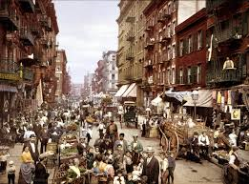
The Urban Frontiers
Rapid Urbanization fueled by Industrialization
Mass Transportation
Skyscrapers
Electric Lights
Shopping
Problems
Waste Disposal
Crime
Overcrowding
Rats
Pollution
Growth of Slums

Slide 3
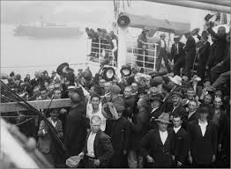
New Immigration
New Immigrants from Eastern and Southern Europe
Illiterate and poor
Created small communities together
Causes
Overpopulation in Europe
Discrimination in Europe
Industrial Jobs available in America

Slide 4
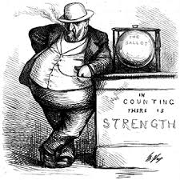
Reactions to Immigration
Political Machines
Led by “Bosses”
Provided jobs and services to immigrants in return for votes

Slide 5
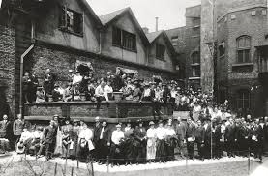
Helping
Settlement Houses
Provided educations, child-care, and other services for the poor and immigrants
Jane Addams
Hull House in Chicago
Inspired other women to create settlement houses

Slide 6
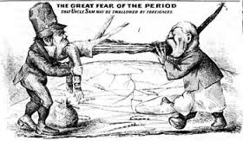
Narrowing the Welcome Mat
Nativism
Favored native-born Americans over immigrants
Afraid immigrants would threaten the national identity
Blamed immigrants for low wages and other urban problems

Slide 7
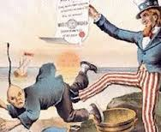
Anti-Immigration Organizations
American Protective Association
Chinese Exclusion Act
Ended Chinese Immigration

Slide 9
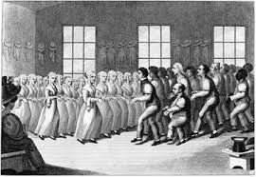
Darwin Disrupts the Churches
Darwin’s “On Origins of Species”
Theory of Evolution/Survival of Fittest
Challenged beliefs of the church
Fundamentalist
Strict interpretation of Bible
Modernist
Blended Science and Christianity

Slide 10
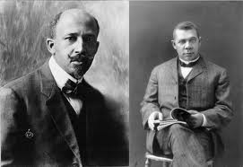
African Americans
Booker T. Washington
Led Black School in Tuskegee, Alabama
Taught that Blacks needed to become economically successful to gain civil rights
George Washington Carver
Taught at Tuskegee Institution
W.E.B. DuBois
Wanted complete equality for Blacks
Helped found the NAACP (National Association for the Advancement of Colored People)

Slide 12
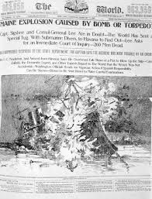
The Appeal of the Press
Spread of Libraries
Rise of Yellow Journalism
Sensational and Exaggerated Stories to sell papers
Focus on scandals

Slide 13
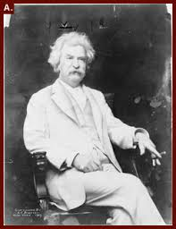
Post-War Writings
Emily Dickinson
Poet
Mark Twain
“Tom Sawyer” and “Huckleberry Finn”
New breed of American Writers
Horatio Alger
Wrote about importance of honesty and virtues
Stephen Crane
Wrote about new urban life

Slide 14
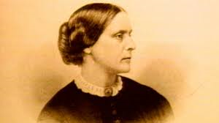
Women in the City
Urban Life
Divorce rates increase
Birthrates decline
Women’s Roles
Became more independent in urban society
Women’s Suffrage
National American Women Suffrage Association
Founded by Elizabeth Cady Stanton and Susan B. Anthony

Slide 15
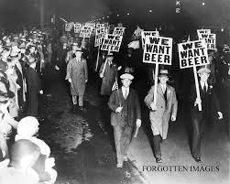
Prohibition of Alcohol
Liquor consumption increased after Civil War
Organizations for Prohibition
National Prohibition Party
Women’s Temperance Union
Anti-Saloon League

Slide 16
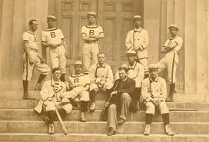
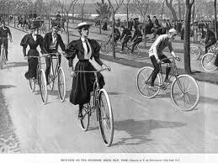
The Business of Amusement
Circuses
Wild West Shows
Baseball
Football
Boxing
Bicycles
Basketball

