Slide 1
America on the World Stage

Slide 2
Causes of Imperialism
Seeking New Markets
Yellow Journalism
Missionaries
Social Darwinism
Competition with other Countries
Control of the Sea

Slide 3
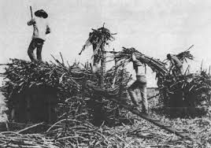
Hawaii
Hawaii important for America
Served as way station for ships
Sugar Plantations
Missionaries
White American planters push for Annexation
Blocked by Queen Liliuokalani
White planters organize revolt and overthrow Queen
Hawaii annexed in 1898

Slide 4
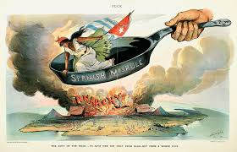
Trouble in Cuba
Cubans revolt against Spanish Rule
Poor treatment of Cubans
Exposed and exaggerated by American Yellow Journalism
Yellow Journalism
Sensational and exaggerated stories to sell papers
U.S. sends battleship Maine to protect and evacuate Americans in Cuba

Slide 5
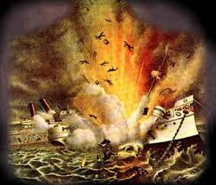
Mystery of the Maine Explosion
Battleship Maine explodes in Cuban harbor
U.S. blames Spain
American public is outraged
Fueled by Yellow Journalism
President McKinley gives in to public demand for war against Spain

Slide 6
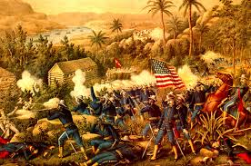
Spanish-American War
Teller Amendment
Promised the U.S. would grant Cubans freedom after the war
A Splendid Little War
U.S. easily defeats outdated Spanish Navy
Rough Riders
Group of volunteers organized by Theodore Roosevelt
Help defeat Spain at San Juan Hill

Slide 7
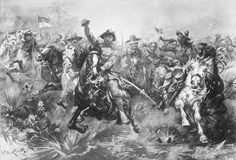
Outcome of War
Cuba free from Spanish Rule
U.S. gets Guam, Puerto Rico, and the Philippines

Slide 8
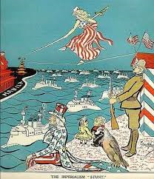
Puerto Rico and Cuba
Widespread Poverty
Puerto Ricans granted U.S. citizenship
Many immigrate to the U.S.
Cuba granted self-rule under Teller Amendment
Platt Amendment
Allowed U.S. to intervene in Cuba
Cuba would lease naval base to U.S.

Slide 9
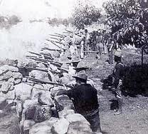
The Philippines
Filipinos wanted self-rule
Lead revolt against U.S. Rule
Put down by U.S.
U.S. improved roads, health, and education
Philippines export sugar to the U.S.

Slide 10
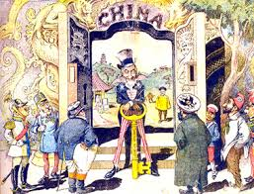
The Open Door Policy
China already divided into economic spheres of influence by Europe
Open Door Policy
Allowed fair competition for trade in China
Boxer Rebellion
Chinese rebels try to drive foreigners out of China
Put down by U.S. and Europeans

Slide 11
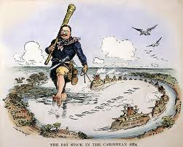
Theodore Roosevelt
Takes over as President after McKinley is shot
Strong supporter of U.S. Imperialism
Roosevelt Corollary
Reinforced the Monroe Doctrine
Justified U.S. intervention in Latin America

Slide 12
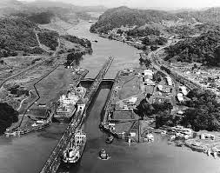
Building a Canal
U.S. wanted to build Panama Canal
Columbia rejects U.S. offer
U.S. helps Panama gain independence
Panama allows U.S. to build canal

Slide 13
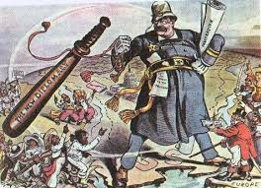
Roosevelt on the World Stage
Helped negotiate end to Russo-Japanese War
Gentlemen’s Agreement
Agreement with Japan to limit Japanese Immigrants in the U.S.
U.S. Navy World Tour

