Slide 1
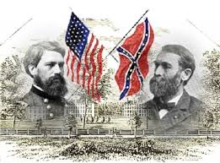
Drifting towards Disunion

Slide 2
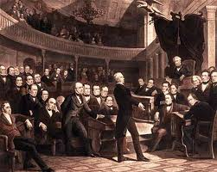
Compromise of 1850
Admission of California as a free state would tip the balance of slave/free states
Compromise of 1850
California admitted as a free state
New Mexico and Utah free to vote on issue
New Fugitive Slave Law

Slide 3
The Underground Railroad
Chain of safe-houses for slaves to escape to the North
Harriet Tubman
One of many leaders of the Underground Railroad

Slide 4
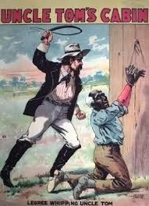
Literary Incendiaries
Harriet Beacher Stowe
Wrote “Uncle Tom’s Cabin”
Helped build support against slavery

Slide 5
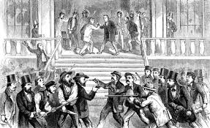
Contest for Kansas
Kansas-Nebraska Bill split Nebraska territory into two states
Slavery left up to vote
Northerners and Southerner flood into Kansas to sway the vote
Violence erupts
The LeCompton Constitution
Pro-Slavery Constitution is voted down

Slide 6
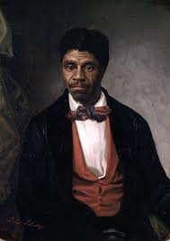
The Dred Scott Bombshell
Dred Scott sues for freedom
Supreme Court rules that Scott was not a citizen and could not sue in courts
Also ruled that slaves were property

Slide 7
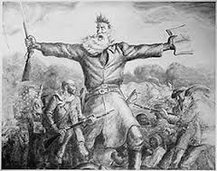
John Brown
Led group of anti-slavers into Virginia and seized arsenal at Harpers Ferry
Wanted to start slave revolt
Brown captured and executed
Became a martyr for Northern Abolitionists

Slide 8
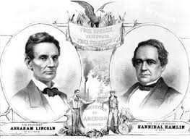
The Election of 1860
Lincoln wins
Over the next six weeks 7 states secede from the Union
4 others join later
Create the Confederate States of America

Slide 9
Fort Sumter
U.S. fort located in S. Carolina
S. Carolina surrounds the fort and take it over
North responds by calling up army
Convince Virginia, Arkansas, Tennessee, and N. Carolina to join the Confederacy

Slide 10
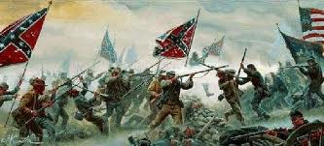
The South
Strengths
Weaknesses
Defensive War
Talented Military Officers
Robert E. Lee
Better Soldiers
Lack of Factories
Weak Economy

Slide 11
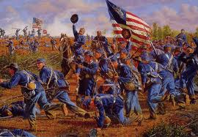
The North
Strengths
Weaknesses
Factories
Wealth
Control of the Sea
Population
Less Prepared Soldiers
Lack of Military Leadership

