Slide 1
Latin American Societies

Slide 2
Government
After initial conquests, more formal government develops in Latin America
Spanish Colonies
Governed by two Viceroys
Portuguese Brazil
Royal Governor oversees

Slide 3
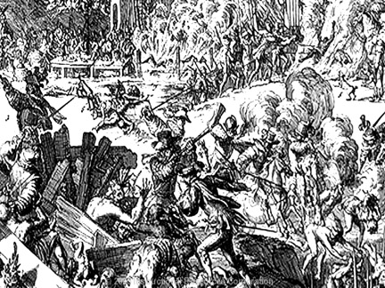
Exploitation of Indians
Labor Systems
Encomienda System
Natives forced to work on Spanish plantations
Mita System
Forced natives in S. America to work on plantations or in the mines

Slide 4
Brazil: Sugar and Slaves
Large Sugar Plantations spread throughout Brazil
Natives resisted farm labor
Large number of African slaves imported to provide labor
Discovery of Gold opens interior regions to settlement

Slide 5
Multiracial Societies
Peninsulares-European born people
Creoles- American born Europeans
Mestizos- Mixed Europeans and Natives
Also Mulattoes and Zambos
Natives and Slaves at the bottom

