Slide 1
The American Revolution

Slide 2
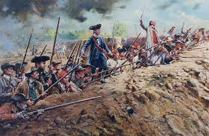
Beginnings of War
George Washington chosen to lead army
Bunker Hill
Colonist capture Bunker Hill
Olive Branch Petition
Last attempt at peace with Britain

Slide 3
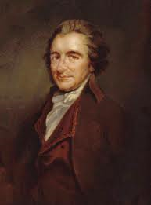
Common Sense
Thomas Paine writes Common Sense
Made strong argument for American Independence

Slide 4
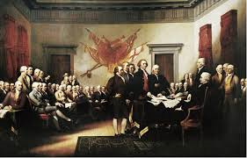
Jefferson’s Declaration
Declaration of Independence
Drafted by Thomas Jefferson in 1776
Listed reasons for American independence
Inspired future revolutionary movements

Slide 5
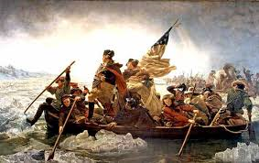
Washington at Bay
Battle of Long Island
Britain defeats Washington and takes New York
Washington retreats to the Delaware River
Surprise attack at Trenton and Princeton
Washington wins surprise attacks against British

Slide 6
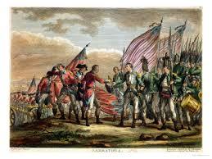
Battle of Saratoga
British plan to divide colonies by capturing the Hudson River Valley
Militiamen trap the British at Saratoga
Victory convinces France to aid colonies

Slide 7
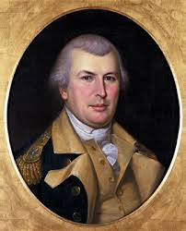
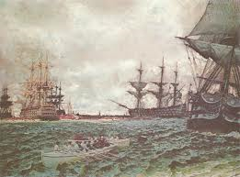
Britain leads attack on the South
British take Georgia and S. Carolina
General Nathanael Greene
Attack and retreat strategy effective in taking back the South

Slide 8
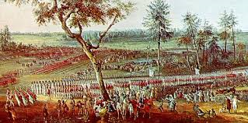
Yorktown
British General Cornwallis falls back to Yorktown awaiting reinforcements
France cuts off British at sea
Washington’s forces surround Yorktown
Cornwallis surrenders

Slide 9
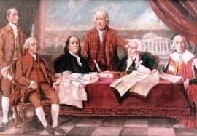
Peace at Paris
Paris Peace Treaty
American gets independence
Also gain large amount of territory in N. America

