Slide 1
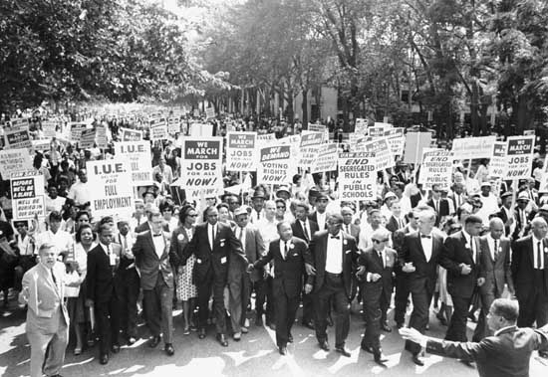
The Civil Rights Movement

Slide 2
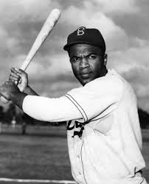
Background
Plessy v. Ferguson (1896)
Separate but Equal was Constitutional
Supported Segregation in the South
Jim Crow Laws
Kept Blacks segregated and without political power
National Association for the Advancement of Colored People (NAACP)
Used the Judicial system to advance rights for African Americans
Jackie Robinson
1st African American in Major League Baseball

Slide 3
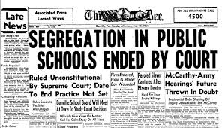
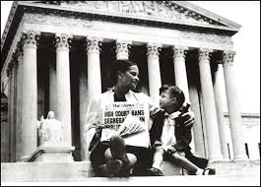
Desegregating the South
Sweatt v. Painter
Ended segregation in professional schools
Brown v. Board of Education (1954)
Ended Segregation in Public Schools
Forced Desegregation in Southern Schools
Much resistance in deep South
Thurgood Marshall
Led defense team for NAACP
Warren Court
Encouraged Supreme Court to confront civil rights issues

Slide 4
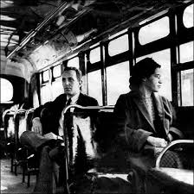
The Civil Rights Movement Begins
Rosa Parks
Refused to give up seat on segregated bus
Led to Montgomery Bus Boycott
Blacks boycotted buses for about a year
Organized by Martin Luther King Jr.

Slide 5
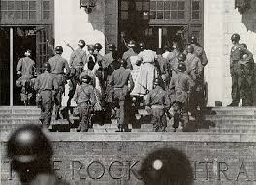
Seeds of the Civil Rights Revolution
Crisis at Little Rock
Orval Faubus (gov. of Arkansas) uses National Guard to deny 9 Black students from enrolling at Central High School
Eisenhower sends in troops to enforce desegregation
Civil Rights Act of 1957
Created Civil Rights Commission
Protected Voting Rights

Slide 6
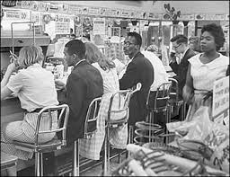
Sit-In Movement
Begins with 4 Black college students demanding service at a “whites only” counter
Sit-ins quickly spread across America
Student Nonviolent Coordinating Committee (SNCC)
Helped organize student protests like sit-ins

Slide 7
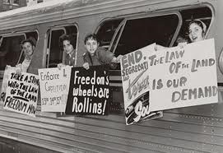
Freedom Riders
Organized by Congress of Racial Equality (CORE)
African Americans and Whites boarded buses to draw attention to the South’s refusal to integrate bus terminals
Many attacked at stops in the South

Slide 8
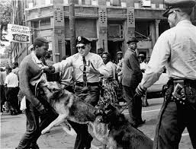
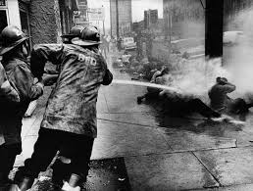
The Struggle for Civil Rights
James Meredith
Becomes first Black student at University of Mississippi
Protected by federal troops
Violence in Birmingham, Alabama
Martin Luther King Jr. organizes campaign to end discrimination in Birmingham
Half population was Black
Demonstrator attacked by police
MLK arrested (Letter from a Birmingham Jail)
Televised: shocked Americans

Slide 9
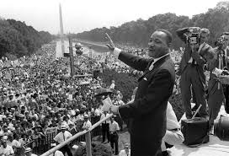
March on Washington
Over 200,000 demonstrators gather near Lincoln Memorial
Martin Luther King
“I Have a Dream” Speech
Helped build momentum for Civil Rights

Slide 10
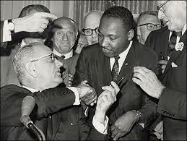
Civil Rights Act of 1964
Banned Racial discrimination and segregation in most public places
Increased governments power to end segregation in schools
Created Equal Employment Opportunity Commission
Eliminated job discrimination
Also ended discrimination based on gender

Slide 11
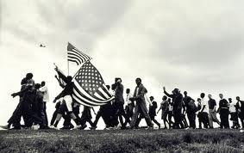
Battling for Black Rights
Selma March
Led by MLK to increase voter registration
Demonstrators attacked by state troopers
Voting Rights Act of 1965
Ensured African American’s right to vote
Ended literacy tests
24th Amendment
Abolished Poll Taxes

Slide 12
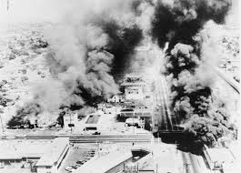
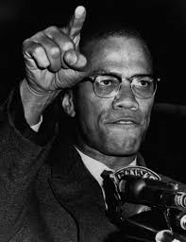
Black Power
Civil Rights Movement becomes more radical
Watts Riots
Blacks loot and burn neighborhood to protest police brutality
Malcolm X and the Nation of Islam
Inspired Black Nationalism
Black Panthers
Militaristic group encourage African Americans to fight for freedoms
Assassination of Martin Luther King Jr
April 4, 1968
Civil Rights Movement loses some vision

