Slide 1
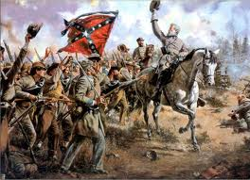
The Civil War

Slide 2
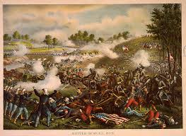
Bull Run
Battle of Bull Run
North wanted to use it as a step towards taking Richmond
“Stonewall” Jackson and the Confederates defeat the North
Ended hopes for a quick war

Slide 3
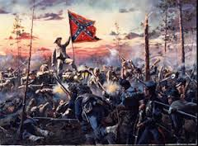
The Peninsula Campaign
General McClellan leads union troops towards Richmond
Robert E. Lee and the confederates defeats McClellan at the Seven Days Battle

Slide 4
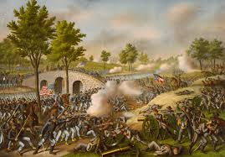
Battle of Anteitam
North finds copy of Lee’s battle plans
One of the bloodiest battles of the war
Lee forced to retreat

Slide 5
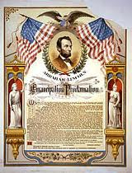
Emancipation Proclamation
Lincoln frees slaves in the Confederacy
Had little immediate impact
Lincoln did not have power in the Confederacy
Stregthened North’s moral cause and made it clear that Lincoln planned to end slavery

Slide 6
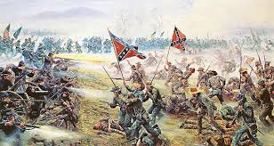
Battle of Gettysburg
Lee advances into Northern territory
Battle of Gettysburg
Seesaw battle at first
Last real chance for the South to win the war

Slide 7
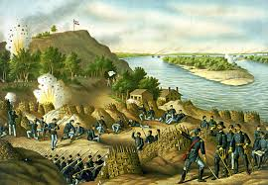
Battle of Vicksburg
Ulysses S. Grant
Becomes leader of Union forces
Captures Vicksburg
Cuts off South’s use of the Mississippi

Slide 8
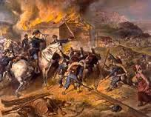
Sherman Scorches Georgia
William Sherman
Put in charge of conquering Georgia
Captures Atlanta
Sherman’s March
Leaves path of destruction through Georgia and S. Carolina

Slide 9
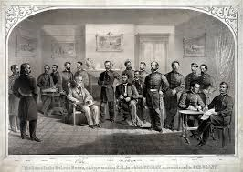
Grant outlast Lee
Grant wins series of campaigns known as the Battle of the Wilderness
Grant captures Richmond (Capital)
Lee forced to surrender at Appomattox Court House

Slide 10
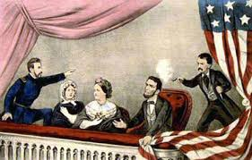
The Martyrdom of Lincoln
Lincoln assassinated at Ford’s Theater 5 days after war
John Wilkes Booth

