Slide 1
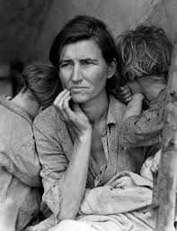
The Great Depression and the New Deal

Slide 2
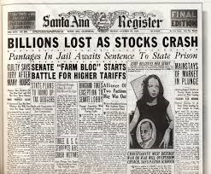
Causes of Depression
Stock Speculation
Buying on Margin
Borrowing Money to invest
Overproduction of Goods
Led to falling prices (esp. Agriculture)
Unequal Distribution of Wealth
Economic Problems Abroad
Stock Market Crash 1929
Black Tuesday
Stock holders pull out of market, causing stock prices to plummet

Slide 3
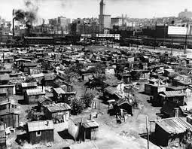
Effects of the Great Depression
Unemployment skyrockets
Wages reduced
Loss of Life Savings
Birthrates Decline
Hoovervilles
Shantytowns grow outside cities

Slide 4
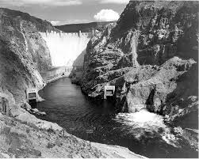
Hoover Battles the Depression
Hoover reluctant to intervene
Supported free enterprise
Did not believe in government handouts
Finally decides to help major industries like railroads and banks
Public Works Projects
Hoover Dam
Reconstruction Finance Corporation
Gave loans to banks and railroads

Slide 5
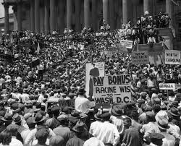
The Bonus Army
WWI veterans march on Washington demanding immediate payouts on war bonuses
Riots break out
Demands are rejected

Slide 6
Hoover Pioneers the Good Neighbor Policy
Good Neighbor Policy
Wanted to improve relationship with Latin America
Withdrew troops
Encourage U.S. Investment

Slide 7
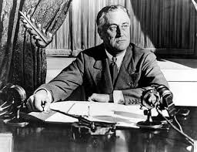
Hoover’s Humiliation in 1932
Fredrick D. Roosevelt
Gov. of New York
Polio
Eleanor Roosevelt
Preached New Deal for the “Forgotten Man”
FDR beats Hoover in 1932 election

Slide 8
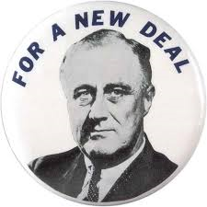
FDR and the 3 R’s
Relief, Recovery, and Reform
100 Days
FDR and Congress pass huge amount of new legislation
New Deal
Aimed at carrying out 3 R’s

Slide 9
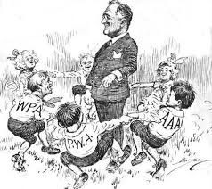
FDR Tackles Money and Banking
Emergency Banking Relief Act
Gave President power to regulate banks
Banking Reform Act
Created Federal Deposit Insurance Corporation (FDIC)
Protected peoples money in Banks
Ended the Gold Standard
Led to “managed currency”

Slide 10
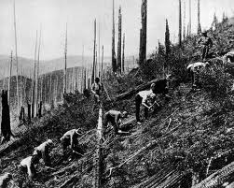
Creating Jobs for the Jobless
Fireside Chats
Civilian Conservation Corps (CCC)
Provided outdoor jobs
Agriculture Adjustment Act (AAA)
Gave money to farmers for mortgages
Home Owners Loan Corporation
Refinanced Homes
Works Progress Administration (WPA)
Spent money on public buildings to create jobs

Slide 11
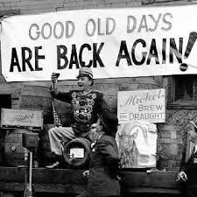
Helping Industry and Labor
National Recovery Administration (NRA)
Spread out hours of labor over more employees
Created a maximum and minimum hours worked per week
Public Works Administration (PWA)
Created public projects to create jobs
21st Amendment
Repealed the 18th Amendment (Prohibition)

Slide 12
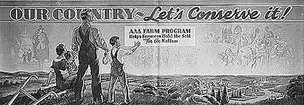
Paying Farmers not to Farm
Farmers suffered from overproduction and low Ag. Prices
Agriculture Adjustment Administration (AAA)
Planned Scarcity
Destroyed crop surpluses
Reduced Agriculture production and raised Ag. Prices
Soil Conservation and Domestic Allotment Act
Paid farmers to leave fields empty

Slide 13
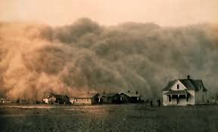
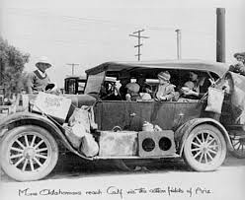
The Dust Bowl
1933 severe drought hits the plains region
No rain and high winds
Top soil eroded due to overuse of land and farming techniques
Effects
Thousands left the plains
Many go to Southern California
Resettlement Administration
Helped farmers find new, productive land

Slide 14
Battling Bankers and Big Business
Securities and Exchange Commission (SEC)
Oversaw the stock market
Federal Securities Act
Required promoters to give accurate stock information to investors

Slide 15
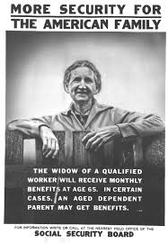
Housing Reform and Social Security
Federal Housing Administration (FHA)
Gave loans for houses or improvements to housing
Still in use today
Social Security Act
Unemployment
Payments for retired workers
Disability payments

Slide 16
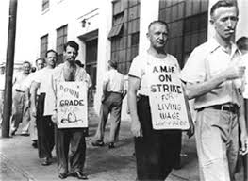
A New Deal for Unskilled Labor
National Labor Relations Act (Wagner Act)
Protected rights of workers to organize and collective bargaining
Sit-down strikes spread
Fair Labor Standard Act (Wages and Hours Bill)
Minimum wage and Max Hours established

Slide 17
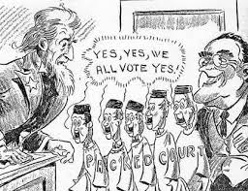
FDR Battles the Supreme Court
FDR tries to get congress to expand the number of supreme court members
From 9 to 15
Shocks Congress and the Public

Slide 18
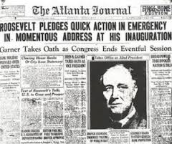
The Roosevelt Recession
Recession in 1937 caused by government cutbacks
FDR begins massive deficit spending to counter
Inspired by John M. Keynes

Slide 19
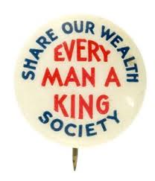
New Deal or Raw Deal?
Criticism of the New Deal
Wasteful Spending
Increased power of government
National Debt
Failed to Cure the Depression
Father Charles Coughlin
Used Radio show to criticize the New Deal
Senator Huey P. Long
“Share Our Wealth” Program
Townshend Plan
Plan to encourage retirement to free up jobs

Slide 20
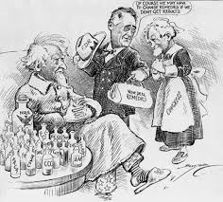
FDR’s Balance Sheet
New Deal provided relief from the Depression
Increased role of Federal Government
Ended some abuses in Business and Capitalism
Provided safeguards to prevent future economic disasters

