Slide 1
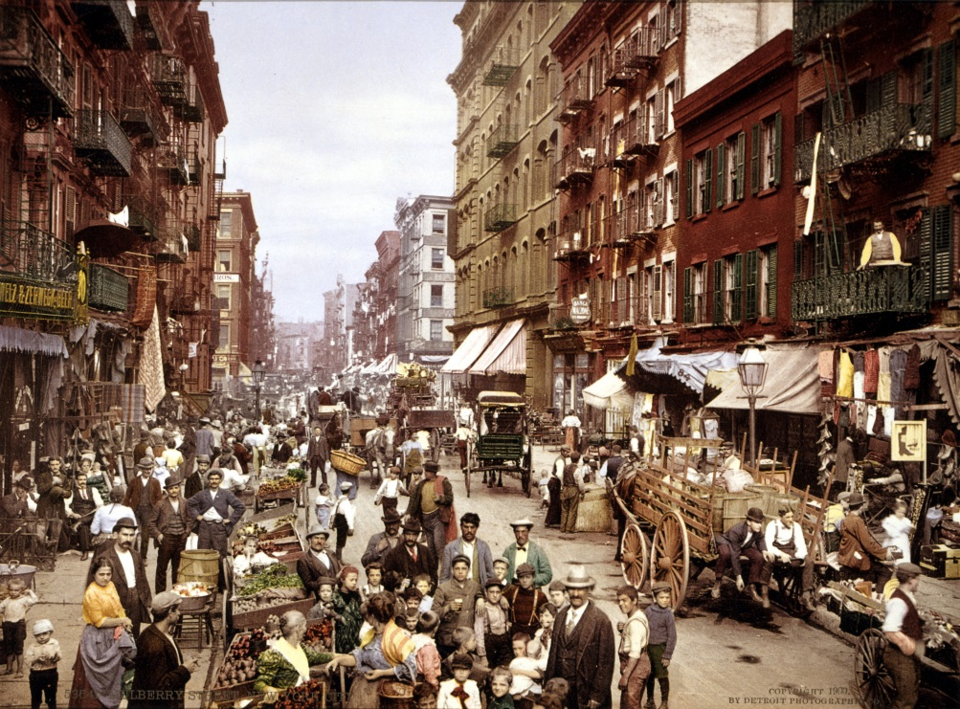
The Progressive Era

Slide 2
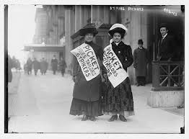
Progressive Roots
Populism
Spread of Socialist Ideas
Social Gospel Movement
Female Activism
Muckrakers

Slide 3
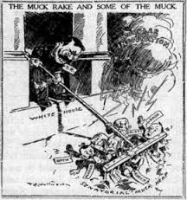
Raking Muck
Muckrakers helped expose many social problems
Lincoln Steffens
Wrote about corrupt “Big Business”
Ida M. Tarbell
Corruption in Standard Oil Company
David G. Phillips
Corruption in the Senate

Slide 4
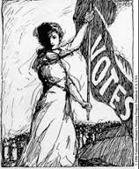
Political Progressivism
Worked to increase citizens power over government
Initiative
Voters could directly propose legislation (laws)
Referendum
Laws placed on ballot for public vote
Recall
Ability to remove elected officials
17th Amendment
Direct Election of U.S. Senators

Slide 5
Progressive Women
Women played a big role in the Progressive movement
Settlement Houses (Jane Addams)
National Consumers League
Fought for better working conditions
Prohibition
Women’s Christian Temperance Movement
Worked to outlaw alcohol
Many states and counties pass “dry” laws

Slide 6
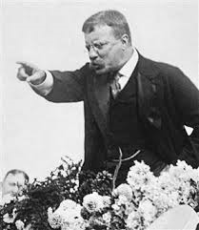
TR’s Square Deal
Control Corporations
Consumer Protection
Conservation of Natural Resources

Slide 7
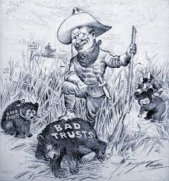
TR Corrals the Corporations
Department of Commerce and Labor
Included Bureau of Corporations
Helped break monopolies and trusts
Stronger regulation of railroads

Slide 8
Caring for the Consumer
Upton Sinclair’s “The Jungle”
Described unsanitary conditions in meat packing industry
Meat Inspection Act
Meat inspected by federal government
Pure Food and Drug Act
Prevented mislabeling of foods

Slide 9
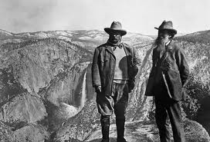
Earth Control
Forest Reserve Act
Newlands Act
Helped bring irrigation to western deserts
Preserved over 125 million acres of forests

Slide 10
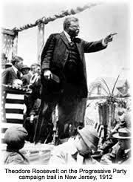
Legacy of Roosevelt
“Trust Buster”
Helped tame monopolies
Conservation
Increased power of the President
Shaped the Progressive Movement
Square Deal
Helped U.S. become bigger World Power

Slide 11
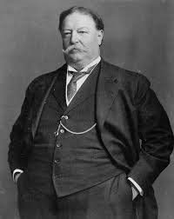
President Taft
Dollar Diplomacy
Favored use of American investments over use of force in foreign policy
Invested in Latin America, but still used force when needed
Payne-Aldrich Bill
Raised tariffs on many goods
Ballinger-Pinchot Controversy
Ballinger opens up reserved lands for development
Pinchot attacks Ballinger, but is released by Taft
Weakens the Republican Party

Slide 12
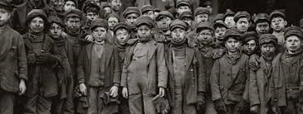
Taft’s Progressive Reforms
Children’s Bureau
Investigated child labor
Bureau of Mines
Monitored mining companies

Slide 13
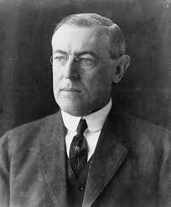
Wilson Progressivism
Woodrow Wilson wins 1912 election
Underwood Tariff Bill
Lowered Tariffs
16th Amendment
Created graduated federal income tax
Federal Reserve Act
Created new federal reserve board
Oversaw 12 regional banking districts

Slide 14
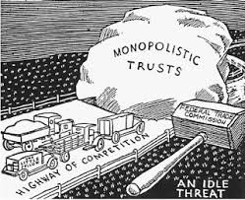
Wilson Tames the Trusts
Federal Trade Commission Act
Appointed commission to oversee industries
Ended many unfair trade practices
Clayton Anti-Trusts Act
Extended power of Sherman Anti-Trusts Act
Added more restrictions to Trusts

Slide 15
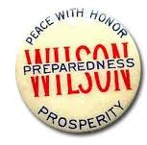
New Directions in Foreign Policy
Wilson withdraws from Roosevelt’s aggressive foreign policy
Disliked Imperialism
Jones Act
Gave Philippines “Territory” status

Slide 16
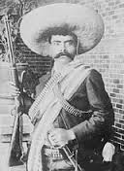
The Mexican Revolution
U.S. investors controlled many industries in Mexico
Revolution in Mexico
Many migrate to U.S.
U.S. sends weapons to revolutionaries trying to overthrow General Huerta
Eventually U.S. troops are sent to try to restore order

Slide 17
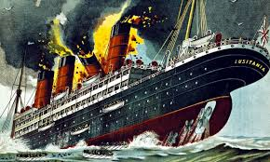
A Precious Neutrality
WWI begins in Europe
U.S. tried to maintain neutrality
U.S. businesses and banks loan money to allies
Helps pull U.S. out of recession
German Submarine Warfare
Germany was attacking ships trading with Britain
Sinking of the Lusitania
British passenger ship with 128 Americans
Outrages American public, but Wilson avoids war
1916 Presidential Election
Wilson Wins under Slogan “He Kept Us Out of War”

