Slide 1
The Vietnam War

Slide 2
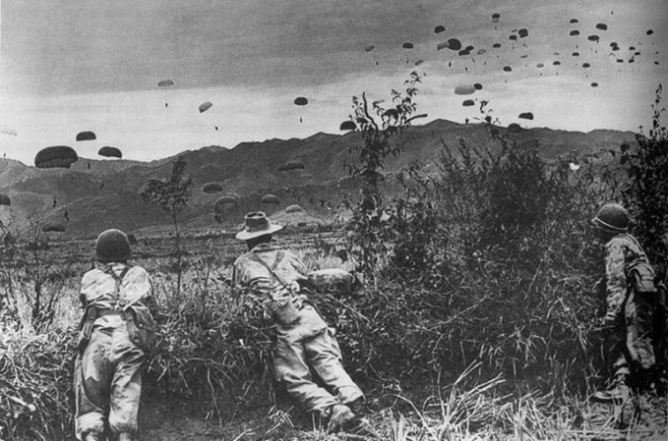
The French in Indochina
France controlled Vietnam after World War II
Vietnam leader Ho Chi Minh leads push for independence
Leaders in East and South-East Asia become increasingly communist
War with France
U.S. supports France against Vietnam
With money and supplies
France lose the War
Vietnam divided under the Geneva Accords
North: Communist
South: Pro-Western regime supported by U.S.

Slide 3
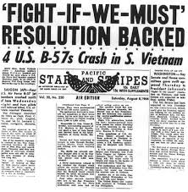
Escalation in Vietnam
Government in S. Vietnam unpopular
Under Ngo Dinh Diem
Corrupt
Attack Buddhism
U.S. send troops to protect Diem government
Diem overthrown
U.S. pulled deeper into Vietnam conflict
Gulf of Tonkin Resolution
Gave President power to make war to protect any country under threat of communist aggression

Slide 4
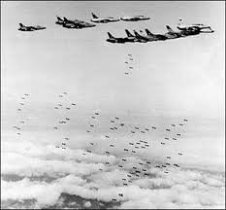
Americanizing the Vietnam War
Operation Rolling Thunder
Increased bombings against N. Vietnam
Americanization
Vietnam war increasingly fought by U.S. Troops
Domino Theory
U.S. afraid if they let S. Vietnam fall to communism, other nations would follow

Slide 5
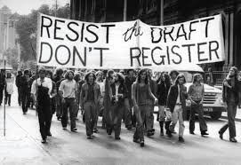
Vietnam Vexations
Discontent to Vietnam War
Anti-war Protests
Draft Dodging
Marches
Opposition in Congress
Senate Committee on Foreign Relations
Credibility Gap
Questioned the truthfulness of the government about the war

Slide 6
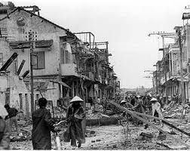
Vietnam Topples Johnson
The Tet Offensive
Viet Cong launch surprise attack in S. Vietnam
Viet Cong defeated after massive casualties
Showed U.S. was not close to winning the war
Lyndon B. Johnson
Announced he would begin to ease U.S. involvement in Vietnam
Also would not run for reelection

Slide 7
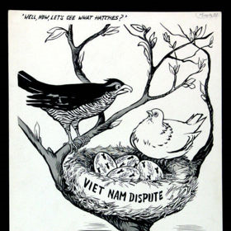
Nixon “Vietnamizes” the War
Vietnamization
Plan to withdraw U.S. troops and turn war over the S. Vietnamese
Anti-War Protestors
Known as “Doves”
Stage protests
Silent Majority
Those who supported the war, but not outspoken

Slide 8
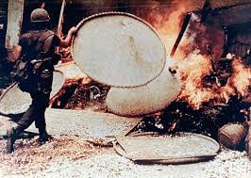
Expanding the Vietnam War
My Lai
U.S. troops massacre women and children in Vietnam village
Ho Chi Minh Trail
Trail to ship supplies from N. Vietnam to Viet Cong in South
Attack on Cambodia
Used by N. Vietnam at station for supplies and troops
Sparked protest in America
Kent State University
4 Protestors killed
Congress repeals the Gulf of Tonkin deal
26th Amendment
Lowered Voting age to 18

Slide 9
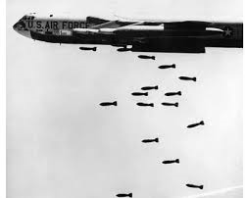
Bombing North Vietnam to the Peace Table
Nixon begins massive bombings against the North
Wanted to force them to peace settlement
Agree to Cease-fire 1973
U.S. withdraws remaining troops from Vietnam

Slide 10
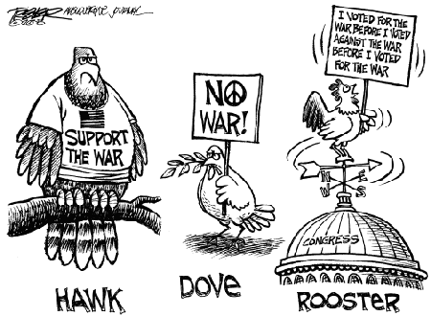
The War Powers Act
Pentagon Papers
Americans find out government had lied about aspects of the Vietnam War
War Powers Act
Required President to report to Congress within 48 hours of committing troops to conflict

Slide 11
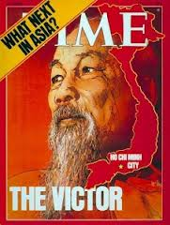
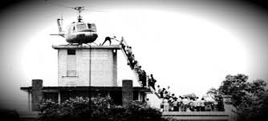
Defeat in Vietnam
1975 North Vietnam takes over the South
Unites Vietnam under Communist regime
America loses prestige and self-confidence

