Slide 1
The West and an Agricultural Revolution

Slide 2
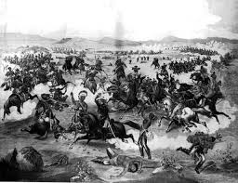
Clash of Cultures
Many natives on the plains wiped out by disease before the Civil War
Many others pushed onto reservations
Indian Wars increase as settlers push West
Sand Creek Massacre
Battle of Little Bighorn
Custer and army wiped out by Sioux
Apache in Arizona
Led by Geronimo

Slide 3
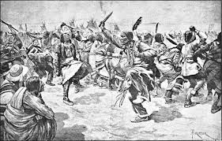
The End of the Trail
Contributing Factors
Spread of Railroads
Disease
Killing of Buffalo
Wounded Knee
Dakota Sioux are massacred
Helped lead to change in Indian policies
Focus on assimilating Indians into American culture

Slide 4
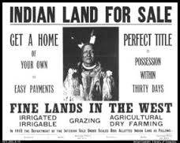
The Dawes Act
Forced civilization/assimilation on Natives
Divided Indian Territory into individual farms
Wanted to turn Natives into American farmers
Set up Indian boarding schools
Taught English and American culture

Slide 5
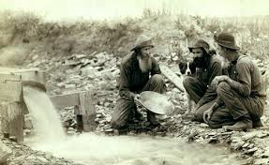
Mining
Gold rushes in Colorado, Nevada, Montana, and Idaho helped fuel settlement
Boomtowns
Miners replaced by corporations
Mining helped settle the West
Attracted gold seekers
Helped spread roads and railroads west

Slide 6
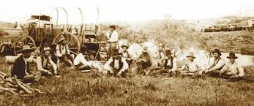
Beef Bonanzas
Railroads aided Beef industry
Cattle Drives
Used to get cattle to markets
Came to an end due to barbed wire and Homesteaders

Slide 7
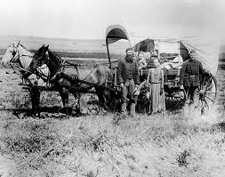
The Farmer’s Frontier
Homestead Act of 1862
Settlers could acquire 160 acres land
Wanted to rapidly settle the plains region
Sodbusters
Heavy Iron Plows
Broke up the tough soil

Slide 8
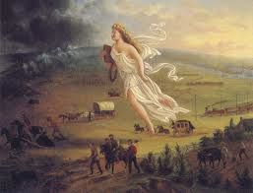
Far West Comes of Age
Opening of Oklahoma
Boomers flood into Oklahoma territory
The Fading Frontier
In 1890 census announced the end of the Frontier
Disappointed America
Frederick Jackson Turner
“The Significance of the Frontier in American History”

Slide 9
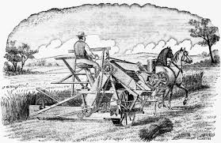
The Farm becomes a Factory
Agriculture Modernization
New Machines
Expensive
Corporate Farms spread

Slide 10
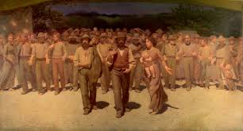
Unhappy Farmers
Many small Farmers forced out
Declining crop prices force Bankruptcy
Many farmers in debt
Railroads were overcharging for shipping

Slide 11
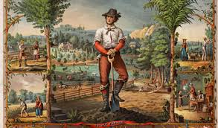
Farmers Take a Stand
Needed a united voice to promote change
The Grange
Worked to improve farmer’s plight
Greenbacks
Fought for improved farming conditions

Slide 12
Populism
Represented Farmer’s interests
Wanted to Regulate Railroads
Wanted a fair income tax
Wanted Unlimited coinage of Silver
To increase money supply

Slide 13
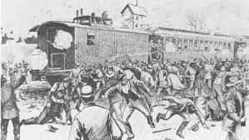
The Pullman Strike
Pullman Palace Car Company
Workers hit hard by 1893 depression
Workers strike is put down by federal troops
Populist and Labor Unions upset that federal government limited their ability to strike

Slide 14
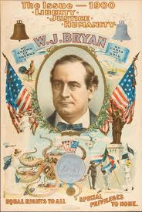
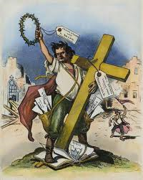
Golden McKinley and Silver Bryan
Presidential Election of 1896
McKinley
Supported Gold Standard and Big Business
William Jennings Bryan
Supported Silver Standard and Agricultural interests
“Cross of Gold Speech”
McKinley Wins
Victory for Big Business, Big Cities, and the Middle Class

